Slide 1
Commercialisation and media
Mr Wills
06/01/2017

Slide 3
What do you notice in these videos ?
Similarities | Differences
https://www.youtube.com/watch?v=zhykeM1XorA
https://www.youtube.com/watch?v=zXzpjbyFIgw

Slide 4
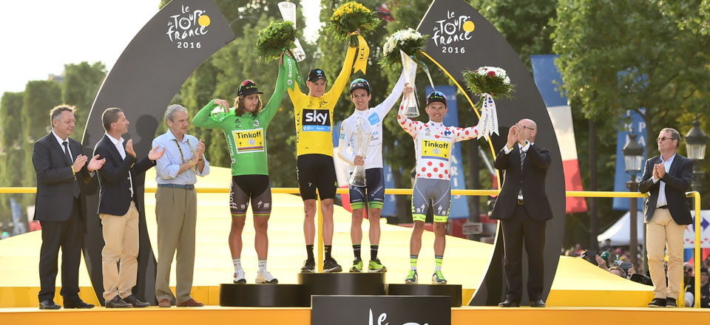
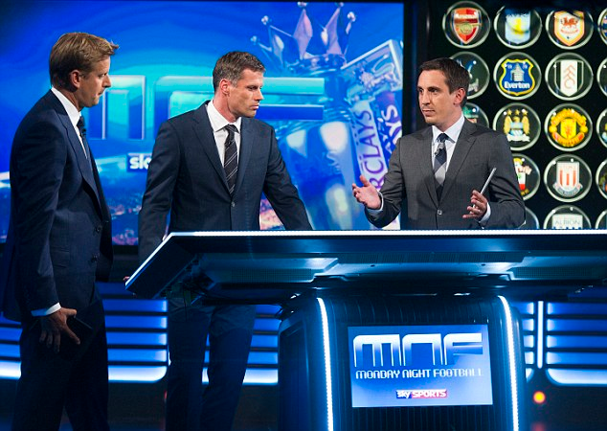
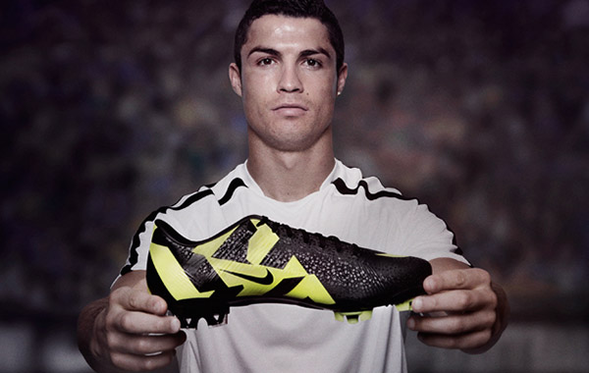
Factors leading to the commercialisation of contemporary physical activity and sport
Why has commercialisation happened?
Growing public interest and spectatorship
More media interest
Professionalism
Advertising
Sponsorship

Slide 5
What are the impacts of commercialisation of physical activity and sport on….
Society
Individual spots
Performers
Spectators

Slide 6
Task/Homework
How has the coverage of sport changed since 1980?
Due 16th January 2017 ☺

