Slide 1
Transfer of Skills

Slide 2
Learning skills
Basic to complex
It is common to teach basic skills first and then to build upon these skills to achieve more sophisticated skills.
Think about primary PE...........

Slide 3
Learning skills
Basic to complex
How would you teach a straddle jump in Gymnastics?

Slide 4
Learning skills
Basic to complex
How would you teach a straddle jump in Gymnastics?
1 – Star jumps, legs wide & straight
2 – Running with two feet take offs
3 – Straddle vault over partner
4 – Straddle jump onto a low vault, with support
5 – Make the vault higher and gradually reduce support

Slide 5
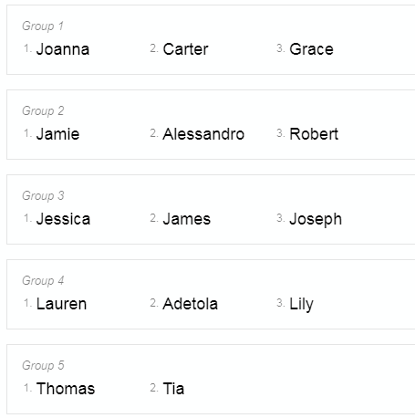
Types of transfer of skills
5 types:
Proactive transfer
Retroactive transfer
Positive transfer
Negative transfer
Bilateral transfer

Slide 6
Research
5 groups
Research 1 type of transfer each.
Teach the class.

Slide 7
Optimising positive effects and limiting negative effects of transfer
Being aware of the theories of transfer of skills.
Make the most of opportunities in training to optimise positive effects.
Explain to the performer how a certain practice might help their development.
Training should emulate the real game situation, to enable to true kinesthetic feeling/get the body used to the true life movement.
Coach should progressive build on skills, to learn sub-routines and build upon another skill.
Avoid too many differing movement patterns to avoid confusing the performer.

Slide 8
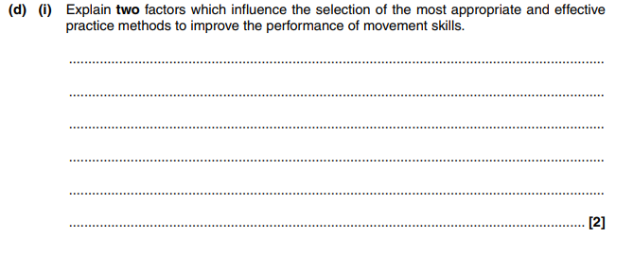
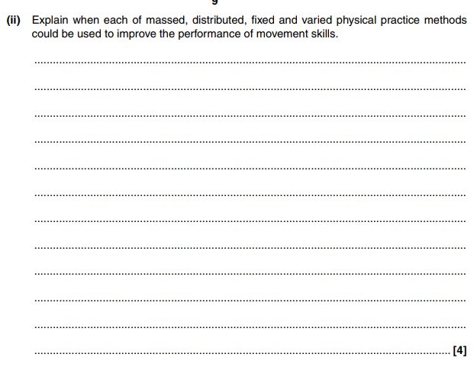
Questions

