Slide 1
Goal setting in sports performance

Slide 2
Groups & teams
Teams operate in groups.
Spectators in groups.
It is important to understand how and why people work together, in order to maximise performance of all within the team.
The process between the group and within the groups is called group dynamics.
The relationships within a group are extremely complex because of the internal and external influence on group performance.

Slide 3
Groups/sports team formation
Tuckman 1965
1 – Forming
2 – Storming
3 – Norming
4 – Performing

Slide 4
Team cohesion
Festinger 1963 – Cohesiveness if the total field of forces which act on members to remain in the group.
Cohesion concerns the motivation which attracts individuals to the group and the resistance of those members to the group breaking up.
Carron 1980 – two dimensions of cohesion
1- Group integration; how individual members of the group feel about the group as a whole.
2- Individual attraction to the group; how attracted the individuals are to the group.

Slide 5
Team cohesion Example – RSA Rugby
1995 RWC Winners
Made up of individuals wo had a high regard for all other members of the ream and who resisted any break-up o the team after the competition finished.

Slide 6
Group/sports team performance
Bringing the best individuals together will increase the chances of you having the best team.
Steiner 1972 model
Actual productivity = potential productivity – loses due to faulty processes.

Slide 7
Group/sports team performance
Actual productivity = potential productivity – loses due to faulty processes.
PP = best possible performance of the group, taking into account resources available, and abilities of individual team members.
LDFP =
1 – Co-ordination problems; if co-ordination and timing of team members do not match, team strategies that depend on them will suffer, and therefore so will team performance.
2 – Motivation problems; if individual members of a team are not motivated to the same extent, they will be pulling in different directions and the potential of the team will not be realised. E.g. Playing netball, some play to win, some play to be with friends.

Slide 8
The Ringelmann effect
The average individual performance decreases as the group size increases.
Rope pulling task, identified that groups pulled with more force that individuals, however each individuals pulling forces was greater.
Eight people pulled only as hard as four times as hard as one, not eight times as hard.
Ingham (1974) showed that this loss in performance was due to both co-ordination and motivational problems, but was mainly caused by individuals within the group losing motivation.
Social loafing – when some individuals lose motivation, when their efforts may not recognised or group identity is disppearing.

Slide 9
The Ringelmann effect
Social loafing – when some individuals lose motivation, when their efforts may not recognised or group identity is disappearing.
Social loafing is undesirable in teams and should be eliminated as far as possible.
If lack of team identity is the reason what could you do ?
To cut down on losses in team performance due to co-ordination difficulties, you should select people based on their interactive skills. It should be emphasised that good co-ordination will eventually lead to better performance. Games using smaller teams may help to co-ordinate the actions of different sets of players within a team.

Slide 10
Goal setting
Goal setting is used to increase a performers motivation, confidence and persistence on task. E.g training or developing skills.
Participants in sport are often faced with complex and threatening situation and may feel anxious.
Goal setting can help to alleviate this anxiety by controlling arousal and ultimately to enhance performance.
Goal setting is used to increase attentional focus and to help to monitor performance.

Slide 11
Four ways goal setting can be used to affect performance.
1 – By directing attention
2 – By regulating the amount of effort put into a given task.
3 – Ensuring effort is sustained until the goal is reached.
4 – By motivating people to develop a variety of strategies to reach their goal

Slide 12
SMART goal setting.
S
M
A
R
T

Slide 13
SMART goal setting.
Specific
Measurable
Achievable
Recorded
Time phased

Slide 14
Types of goals
Outcome goals
Performance goals
Process goals

Slide 15
Types of goals
Outcome goals – goals that are targets directed towards an end result of the activity eg. Wanting to win a netball match.
Performance goals – goals that are directed towards the individual's end performance eg. Improve my batting average in cricket.
Process goals – goals that are used to improve a skill and are often related to technique eg. Improve my batting technique in cricket.

Slide 16
Types of goals
Other factors affecting goal setting
Long term goal is a progressive process and must start with achieving a short term goal.
Short term goal provide a greater opportunity for success, which can reinforce positive feelings and in turn help control anxiety levels.
Many athletes use realistic target dates to help them achieve their short-term goals.

Slide 17
Effective goal setting
There must be a breakdown of the overall goals that you want to achieve for goal setting to be effective.
Eg. To win the league, the team may have to concentrate on winning more games away from home. For this to be achieved there may be short-term goals of improving the attacking of the team.
It can be more motivating to split long term goals into medium term and short term goals which are more specific and manageable over a short period of time.

Slide 18
Sharing decision-making
Goals that are set through negotiation and agreement are far more effective than externally set goals.
The participant will have a sense of ownership over the goal setting and will be better motivated to achieve.
Goal setting is also likely to be fairer and more realistic if all parties involved have an input.

Slide 20
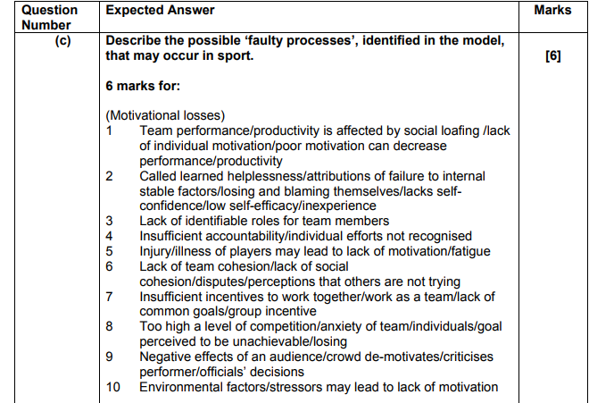

Slide 21
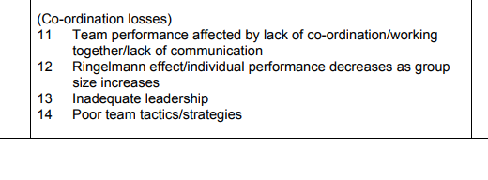

Slide 23
