Slide 1
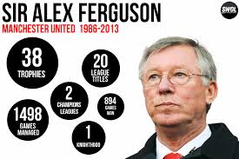
Leadership in Sport
WLS

Slide 2
Leadership
An individual having enough influence over the behaviour of others.
Motivate others to follow goals.
Effective leaderships impacts on performance.
A good leader can motivate others and can give focus or direction towards goals.

Slide 3
Leadership
"as the behavioral process influencing individuals and groups towards set goals" Barrow 1977.

Slide 4
Leadership
List as many different leader positions in sport.

Slide 5
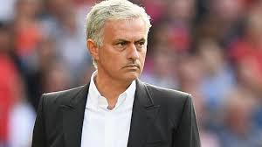
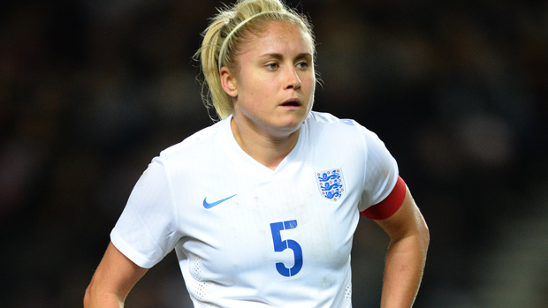
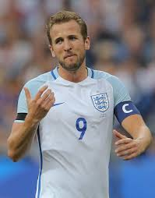
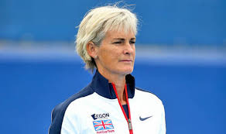
Leadership
List as many different leader positions in sport.
- Captain
- Manager
- Director
- Coach
- Physiotherapist
- Team sports pschologist
All these positions need leadership qualities.

Slide 6
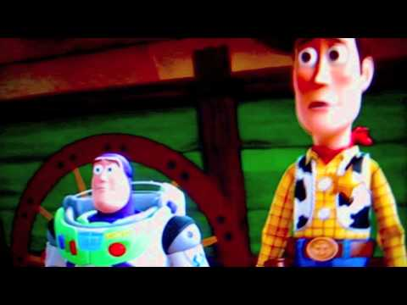
What makes an effective leader?

Slide 7
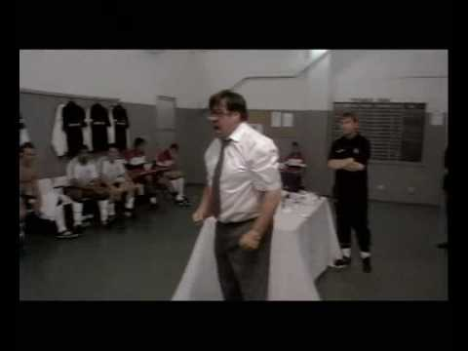
What makes an effective leader?
Good communication skills
High motivation
Enthusiasm
Clear goal or vision
Empathy
Good at the sport themselves (is this always the case)
Charismatic
Some of these qualities are learned, some may be seen as innate or natural.
Is a leader born or made?

Slide 8
Emergent and prescribed leaders
Emergent leaders come from within the group.
Prescribed leaders are appointed from external.
Why?
Advantages/disadvantages are both?

Slide 9
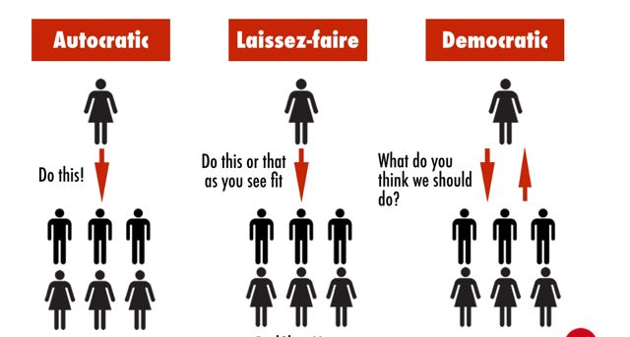
Leadership styles
Autocratic/authoritarian leadership
Democratic leadership
Laissez-faire leadership
Describe each leadership style, and explain how and why they are used.

Slide 10
What do you prefer?
Identify your preferences for coaching behaviour, either as a coach or as a performer.
What sort of atmosphere do you thrive in?

Slide 11
What do you prefer?
Identify your preferences for coaching behaviour, either as a coach or as a performer.
Generalisations:
- Novice prefer more rewards experts prefer more democratic and social support coaching.
- Team members prefer more training and instruction, autocratic coaching and rewards. Individual sports people prefer democratic coaching and social support.
- Male athletes prefer a more autocratic style of coaching and females prefer a democratic style.
- Older athletes prefer democratic coaching, social support and training and instruction. Athletes of all ages value rewards equally.

Slide 12
What style of leadership would you adopt in the following situations ?
You are introducing yourself as the new coach to a hostile group.
You would like to bring together a very large group of athletes as a team before a big meeting.
You are coaching a highly skilled tennis player.
A friendly, successful team of cricket players ask you to be their coach.
A novice weightlifter needs coaching just before the lift.
Consider characteristics of the leader, situational factors, team member's characteristics.

Slide 13
Theories of Leadership
Trait perspective
Social learning theory
Interactionist theory
Notes:
Studied under personality.

Slide 14
Theories of Leadership
Trait perspective
Genetic disposition or innate characteristics that show leadership qualities.
Great leaders are born and not made.
Leaders do have certain characteristics that make them effective, doubts whether this is all innate.
Leadership traits are stable and enduring and can be generalised across different situations that make some people leaders in all situations that they are in.
There are arguments against this theory; people in sport tend to be quite specific in their leadership skill.
The environment is not taking into account.
Notes:
Studied under personality.

Slide 15
Theories of Leadership
Trait perspective
- Certain traits produce certain patterns of behaviour.
- These patterns are consistent across different situations.
- People are born with these leadership traits.
Notes:
Studied under personality.

Slide 16
Theories of Leadership
Social learning theory
Leadership chracteristics are learning from others.
Behaviour of others is watched and copied (vicarious learning).
Observing others showing leadership behaviour, if that person is of higher status to you, you are more likely to copy that behaviour.
Theory shows the importance of the social environment for adopting leadership qualities.
Notes:
Studied under personality.

Slide 17
Theories of Leadership
Interactionist theory
- Individuals may well have certain in-born traits, such as assertiveness, but are not evident unless a situation demands the leadership behaviour.
- Some people are not generally leaders in everyday life, but can show leadership qualities in sports situations.
Involves the interaction of traits and the changing environment.
Notes:
Studied under personality.

Slide 18
Chelladurai's multi-dimensional model of sports leadership
http://www.showme.com/sh/?h=ZFuURCy

Slide 19
Theories of Leadership
Trait perspective
Social learning theory
Interactionist theory
Notes:
Studied under personality.

